Slide 1
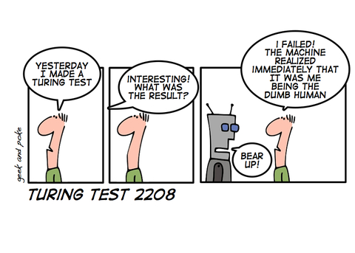
NBA & Machine Learning
Team Syntax Error
Fernanda & Sarah & Rick & Neel & Alan

Slide 2
Machine Learning

Slide 3
Model Performance on Test Data
Label | # of Occurences | # of Correct Predictions | Accuracy
Out | 35 | 34 | 0.97
R1 | 20 | 15 | 0.75
CSF | 10 | 0 | 0
CF | 5 | 1 | 0.2
F | 2 | 1 | 0.5
Champion | 3 | 0 | 0
 | 75 | 51 | 0.68
Label | # of Occurences | # of Correct Predictions | Accuracy
Out | 35 | 34 | 0.97
R1 | 20 | 15 | 0.75
CSF | 10 | 0 | 0
CF | 5 | 1 | 0.2
F | 2 | 1 | 0.5
Champion | 3 | 0 | 0
 | 75 | 51 | 0.68

Slide 4
$ on the SUNS!

Slide 5
Prediction Model in Training Data:
Terms | Coefficient | Significance
Intercept | -53.047 | ---
FGM | 5.687 | p < .001
FTM | 2.619 | p < .001
OREB | -0.792 | p = .005
DREB | 1.089 | p = .002
Opponent FGM | -4.480 | p < .001
Opponent FTM | -2.690 | p < .001
Opponent OREB | 0.790 | p = .140
Opponent DREB | 0.356 | p = .222
Predicted NBA Wins = -53.05 + 5.69(FGM) + 2.62(FTM) – 0.79(OREB) + 1.09(DREB) – 4.48(OppFGM) – 2.69(OppFTM) + 0.79(OppOREB) + 0.36(OppDREB)
Multiple R² in Training Data = .859
Multiple R² when Training Model Applied to Test Data = .788
The intercept is a placeholder since no NBA team can win negative games.
Strongest predictors of Wins were FG and FT Made Per 100 Possessions
Opponent Rebounding Statistics were not significant predictors of Wins, and can be excluded from the ML Model

Slide 6
Predicting NBA Wins
Complete team statistics from 10 NBA seasons
Training data: 2009-10 to 2013-14 NBA Seasons
Test data: 2014-15 to 2018-19 NBA Seasons
Predicting NBA Wins
Strike shortened NBA season to 66 games in 2011-12
Dependent variable: Expected Wins per 82 games (Win % X 82)
Predictors:
FGM, FTM, OREB, DREB Per 100 Possessions*
Opponent FGM, FTM, OREB, DREB Per 100 Possessions
*Field Goals Made, Free Throws Made, Offensive Rebounds, Defensive Rebounds

Slide 7
Predicting NBA Wins
Complete team statistics from 10 NBA seasons
Training data: 2009-10 to 2013-14 NBA Seasons
Test data: 2014-15 to 2018-19 NBA Seasons
Predicting NBA Wins
Strike shortened NBA season to 66 games in 2011-12
Dependent variable: Expected Wins per 82 games (Win % X 82)
Predictors:
FGM, FTM, OREB, DREB Per 100 Possessions*
Opponent FGM, FTM, OREB, DREB Per 100 Possessions
*Field Goals Made, Free Throws Made, Offensive Rebounds, Defensive Rebounds

Slide 8
Prediction Model in Training Data:
Predicted NBA Wins = -53.05 + 5.69(FGM) + 2.62(FTM) – 0.79(OREB) + 1.09(DREB) – 4.48(OppFGM) – 2.69(OppFTM) + 0.79(OppOREB) + 0.36(OppDREB)
Multiple R² in Training Data = .859
Multiple R² when Training Model Applied to Test Data = .788
Terms | Coefficient | Significance
Intercept | -53.047 | ---
FGM | 5.687 | p < .001
FTM | 2.619 | p < .001
OREB | -0.792 | p = .005
DREB | 1.089 | p = .002
Opponent FGM | -4.480 | p < .001
Opponent FTM | -2.690 | p < .001
Opponent OREB | 0.790 | p = .140
Opponent DREB | 0.356 | p = .222
The intercept is a placeholder since no NBA team can win negative games.
Strongest predictors of Wins were FG and FT Made Per 100 Possessions
Opponent Rebounding Statistics were not significant predictors of Wins, and can be excluded from the ML Model

Slide 9
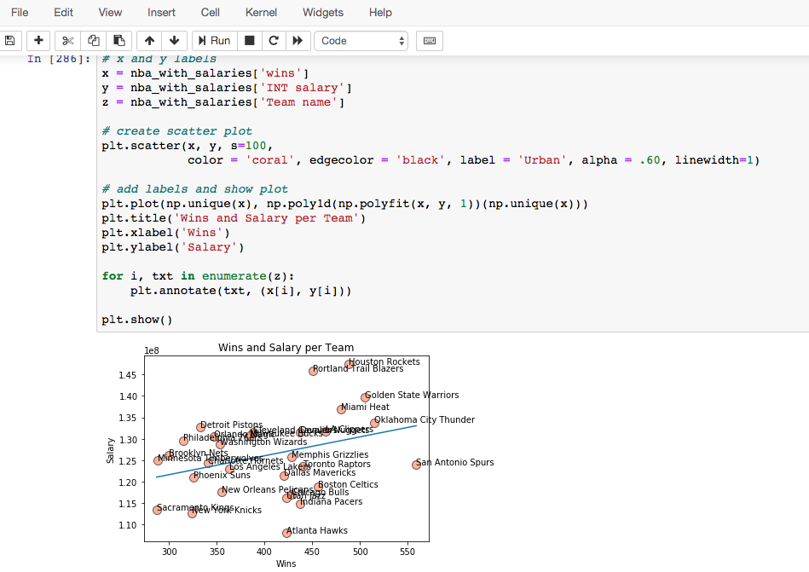

Slide 10
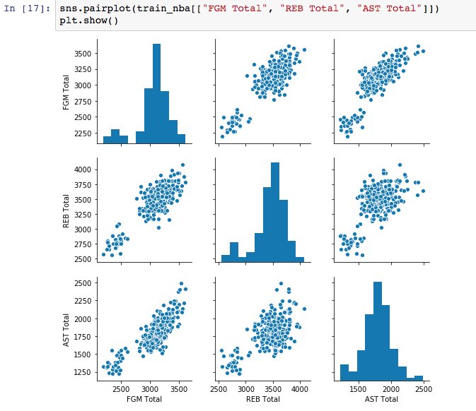
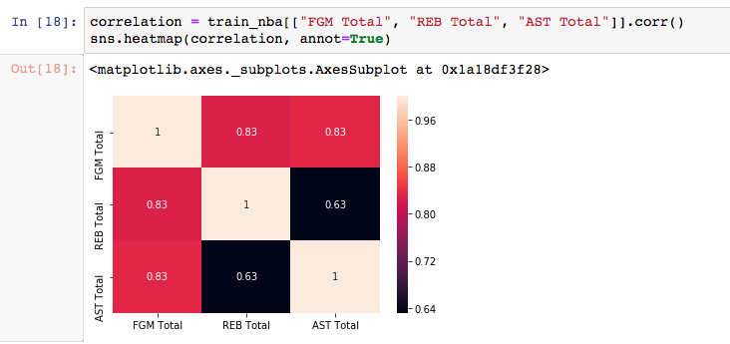

Slide 11
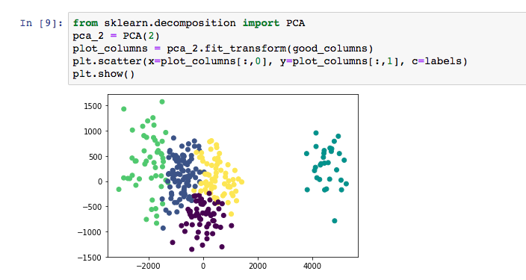

Slide 12
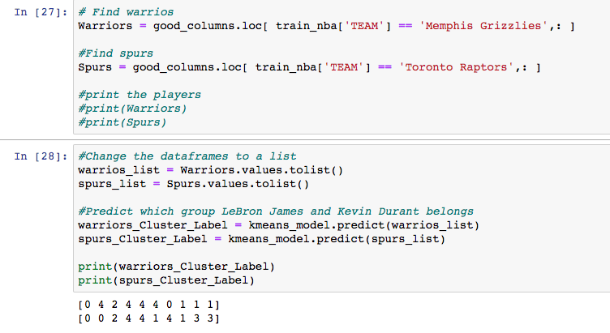

Slide 13
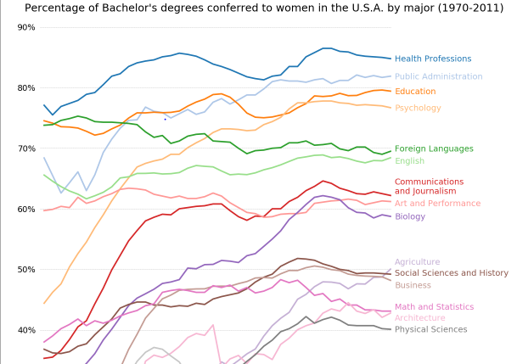
Alan & the Saga of Matplotlib

Slide 14
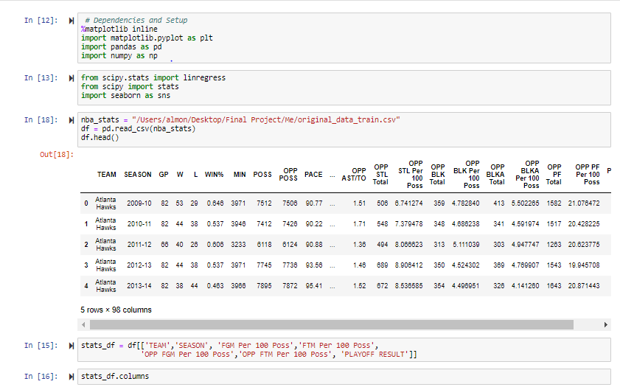
Alan & the Saga of Matplotlib ************* Again

Slide 15
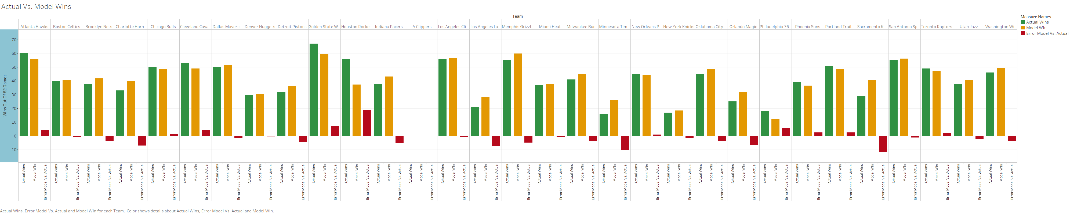
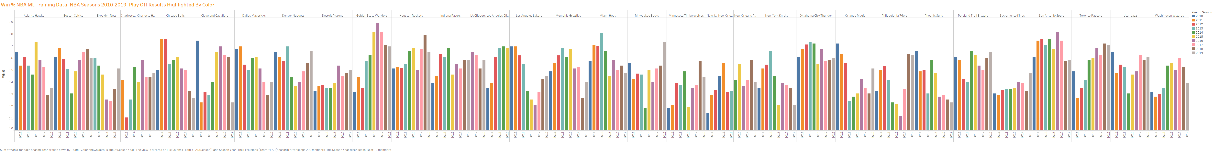
POWER OF TABLEAU
The trials and tribulations of creating visual aids while not understanding any of the Data

Slide 16
Sarah
Creating New Data to Support the Existing Data
Creating Geocoding and using Geocodio
Understanding Data, Jargon, and Abbreviations for the NBA
Limitations of Tableau
Time!

